Slide 1
How to best use these slides…
View the PPT as a slide show
Then click through every step
Mouse clicks will advance the slide show
Left/right arrow keys move forward/backward
Mouse wheel scrolling moves forward/backward
When a question is posed, stop and think it through, try to answer it yourself before clicking
If you have questions, email me, ask in the Teams Student Center channel!

Slide 2
LESSON 6.5b
Change of Base Formula for Logarithms

Slide 3
Today you will:
Learn how to use the “Change of Base” Formula for logarithms to solve “unusual” log problems.
Practice using English to describe math processes and equations

Slide 4
Core Vocabulary:
Change-of-Base Formula, p. 329
Previous:
Base of an exponent and of a logarithm

Slide 5
Logarithm
Another way of writing $y=b^{x}$
$$\log_{b}{y}=x$$
Read it as “Log base $b$ of $y$ is $x$”
…as an exponential function it is $b$ to the $x$ is $y$

Slide 6
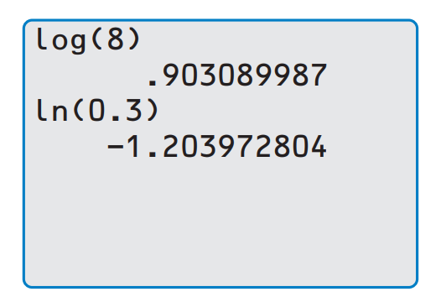
You know how to use your calculator to solve the following:
$$\log{8}$$
or
$$\ln{0.3}$$
…use the “log” and “ln” buttons on the far left of your TI calculator…

Slide 7
…but what about something like:
$$\log_{13}{1.35}$$
there is no button for logarithm using any base other 10 or e
…what to do? …what to do?

Slide 8
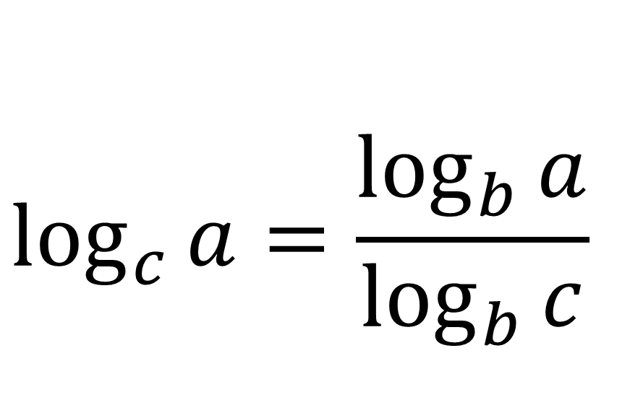
Change-of-Base Formula for Logarithms
$$\log_{c}{a}=\frac{\log_{b}{a}}{\log_{b}{c}}$$
Pick your base!
What would be some good bases to use?
base 10
or
base e
they’re on your calculator!

Slide 9
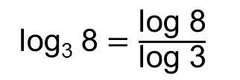
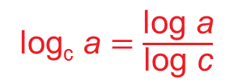
Evaluate log₃ 8 using common logarithms.
SOLUTION
In Example 4, log₃ 8 can
be evaluated using natural logarithms.
log₃ 8 $=$ $\frac{\text{ln}\text{ 8}}{\text{ln}\text{ 3}}$ $≈$ 1.893
Notice that you get the
same answer whether you use natural logarithms or common logarithms in the
change-of-base formula.
log₃ 8 $=$ $\frac{\text{log}\text{ 8}}{\text{log}\text{ 3}}$
log_{c} a $=$ $\frac{\text{log} \text{a}}{\text{log} \text{c}}$
$≈$ $\frac{\text{0.9031}}{\text{0.4771}}$ $≈$ 1.893
Use a calculator. Then divide.

Slide 10
Evaluate log₆ 24 using natural logarithms.
SOLUTION
log₆ 24 $=$ $\frac{\text{ln}\text{ 24}}{\text{ln}\text{ 6}}$
log_{c} a $=$ $\frac{\text{ln} \text{a}}{\text{ln} \text{c}}$
$≈$ $\frac{\text{3}\text{.}\text{1781}}{\text{1}\text{.}\text{7918}}$ $≈$ 1.774
Use a calculator. Then divide.

Slide 11
For a sound with intensity I (in watts per square meter), the loudness L(I ) of the sound (in decibels) is given by the function
L(I) $=$ 10 log $\frac{\text{I}}{\text{I}\text{0}}$
where I₀ is the intensity of a barely audible sound (about 10⁻¹² watts per square meter). An artist in a recording studio turns up the volume of a track so that the intensity of the sound doubles. By how many decibels does the loudness increase?
SOLUTION
Let I be the original intensity, so that 2I is the doubled intensity.
increase in loudness $=$ L(2I ) $−$ L(I )
Write an expression.
$=$ 10 log $\frac{\text{2}\text{I}}{\text{I}\text{0}}$ $−$ 10 log $\frac{\text{I}}{\text{I}\text{0}}$
Substitute.
$=$ 10 $\left(\text{log} \frac{\text{2}\text{I}}{\text{I}\text{0}} − \text{log} \frac{\text{I}}{\text{I}\text{0}}\right)$
Distributive Property
$=$ 10 $\left(\text{log}\text{ 2}+\text{log} \frac{\text{I}}{\text{I}\text{0}} − \text{log} \frac{\text{I}}{\text{I}\text{0}}\right)$
Product Property
$=$ 10 log 2
Simplify.
The loudness increases by 10 log 2 decibels, or about 3 decibels.

Slide 12
REVIEW: Change-of-Base Formula for Logarithms
$$\log_{c}{a}=\frac{\log_{b}{a}}{\log_{b}{c}}$$
Pick your base!
What would be some good bases to use?
base 10
or
base e
they’re on your calculator!

Slide 13
Homework
Pg 332, #33-45

